Slide 1

UNLOCKING
Liane Stevenson @webdevelopwolf

Slide 2
INTRODUCTION
Welcome to CodeUP Stoke-on-Trent!

Slide 3
What Did We Do Last Month?
Finding out what Ionic is and does
Starting our first Ionic Mobile App
Looking at how navigation works in Ionic
Creating a skeleton app

Slide 4
What Are We Doing Today?
Forget what you know about the navigation stack (trust me)
Types of navigation
What Ionic can really do with some cool components

Slide 5
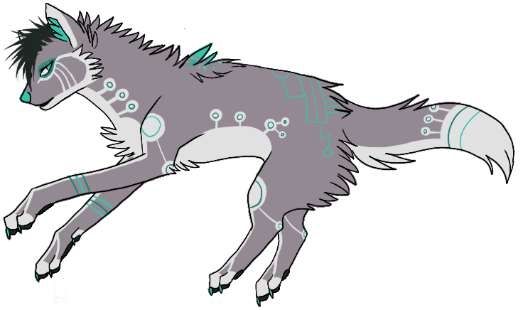
NEED HELP?
Github:
http://www.github.com/webdevelopwolf/training
Twitter:
http://www.twitter.com/webdevelopwolf
Facebook:
http://www.facebook.com/webdevwolf

Slide 6
NAVIGATION RECAP
What do we already know about the Ionic Navigation Stack?

Slide 7
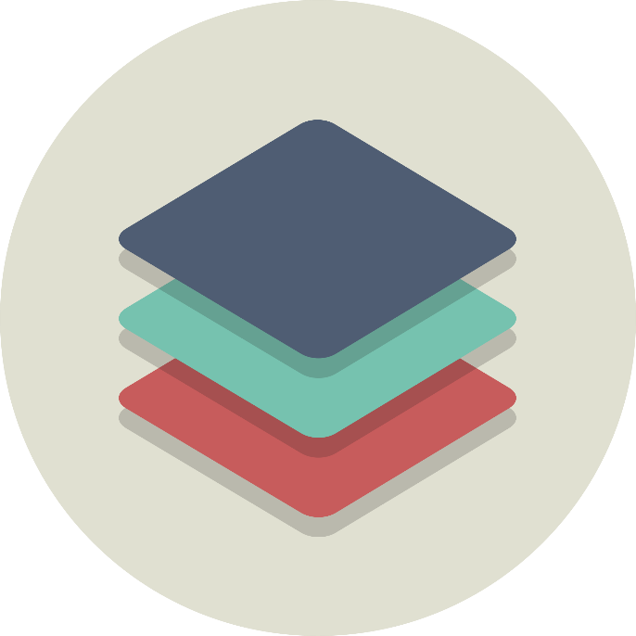
THE NAVIGATION STACK
Without us even realising it, Ionic is creating a stack of pages as we navigate around the app
Newly opened pages get pushed onto the stack and when we hit the back button, the last page is popped off the stack
Most applications will only have one stack, however Ionic does support more than one stack

Slide 8
USING THE NAVIGATION STACK
We add and remove items to and from the navigation stack with the help of the NavController.
This is pre-imported into pages generated in Ionic using the command we ran previously
We create our own instance of the NavController and ‘push’ the page we want to navigate to onto the stack, like so…
You’ll notice when we test this, we already have a back button that automatically returns us to the home page that we started on. To mimic this behaviour we can ‘pop’ the current page off the stack in a similar way to how we pushed the page onto the stack

Slide 9
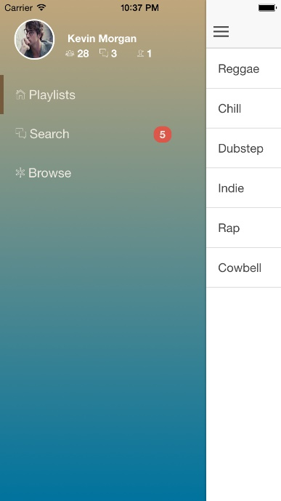
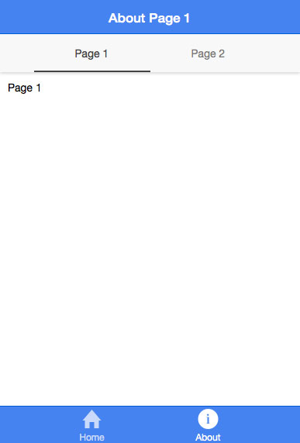
NAVIGATION TYPES
There are two types of navigation in Ionic
Side Menu $ ionic start myApp sidemenu
Tabs $ ionic start myApp tabs
We can use both together, but for usability reasons it’s best to choose one
So, which one is right for your app? First lets think of our users

Slide 10
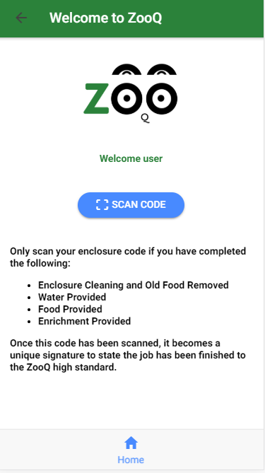
NAVIGATION TYPES - TABS
Tabs give the user a very familiar user experience and improve the look and feel of small apps
The example to the side simply use’s the phones camera to read a QR or barcode
We want it to feel like a extension of the phone itself instead of a unique, independent experience

Slide 11
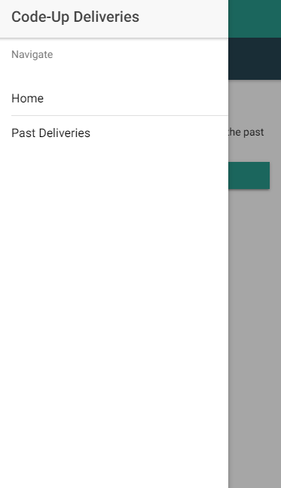
NAVIGATION FOR OUR DELIVERY APP
We have a lot of pages to navigate with our Delivery App – which could leave the tabs bar cluttered – so we put it in a side menu
We can also customise our side menu giving the user a richer experience
Let’s take a look at how we’d do this in our app, time to give those skeletons some funny bones…

Slide 12
UNLOCKING IONIC
A pandora’s box of awesome, powerful components

Slide 13
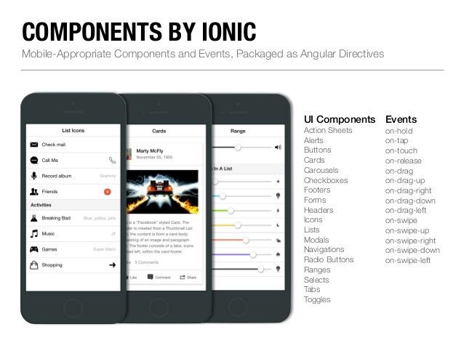
WHOA LI, SLOW DOWN! WHAT’S A COMPONENT?
“Ionic apps are made of high-level building blocks called components. Components allow you to quickly construct an interface for your app. Ionic comes with a number of components, including modals, popups, and cards. Check out the examples below to see what each component looks like and to learn how to use each one. ”
From Ionics Online Documentation

Slide 14
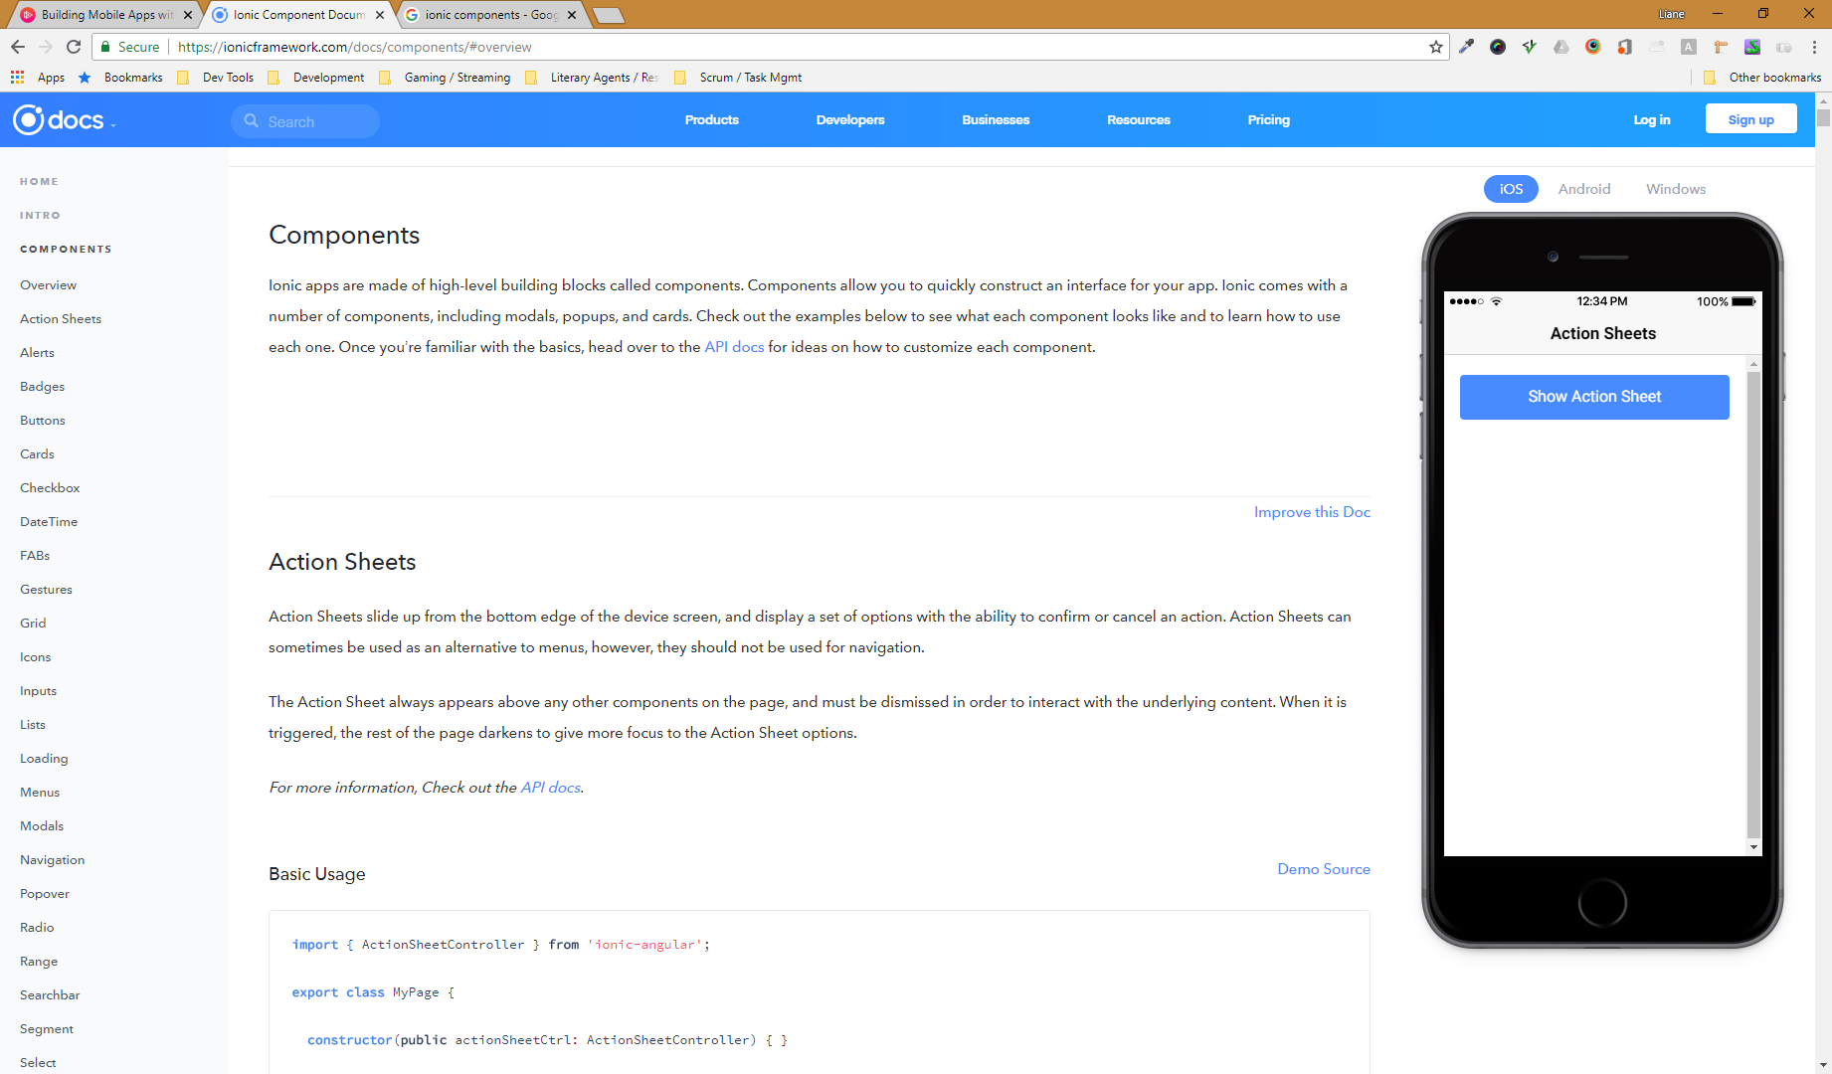
A SMALL DISCLAIMER…
There are 20 + components in Ionic
Loads more can added using plug-ins
We can’t cover them all in depth (well we could, but it may blow your minds and you’ll need them to build all your cool apps)
We’ll cover as many as possible, but we’ll be covering them in a little bit of a fly-by fashion
However, you can learn more about components in the Ionic Documentation
You don’t have to read it all, just take a look at the stuff you find cool and interesting

Slide 15
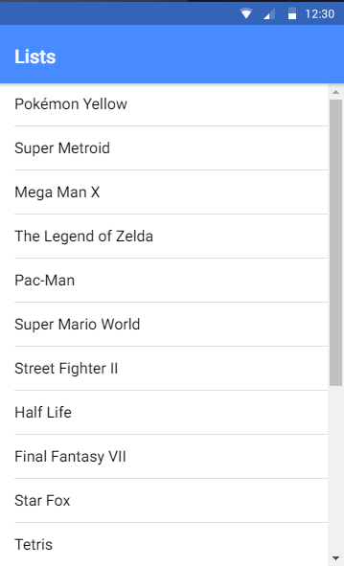
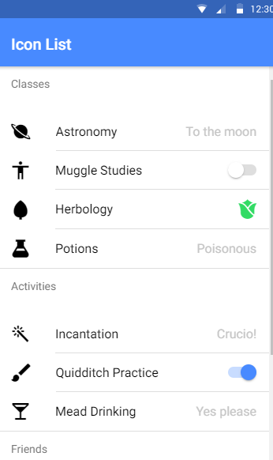
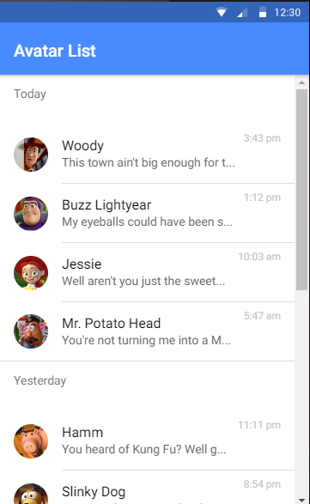
LOVELY LISTS
First of all, let’s see one of the most commonly used components in Ionic…lists
Lists are used to display rows of information, such as a contact list, playlist, or menu.
The look and feel of these lists is really familiar to most smart phone users
There are many different types of lists including:
Basic Lists
Inset List
List Dividers
List Headers
Icon List
Avatar List
Multi-line List
Sliding List
Thumbnail List
Let’s take a look at adding these to our app to display our past deliveries…

Slide 16
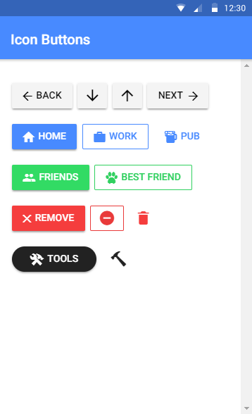
BRILLIANT BUTTONS
If lists are the most popular component in Ionic, then buttons are a very close second
Buttons are an essential way to interact with and navigate through an app, and should clearly communicate what action will occur after the user taps them. Buttons can consist of text and/or an icon, and can be enhanced with a wide variety of attributes.
In short, buttons can be whatever you need them to be. We can have unique looks and styles or stick with a very familiar format, but their main function is to navigate the application and push and pop pages on and off our navigation stack
Here’s some of the cool things we can do with buttons:
Default Style
Outline Style
Clear Style
Round Buttons
Block Buttons
Full Buttons
Button Sizes
Icon Buttons
Buttons In Components
Let’s add a button to our app that tells the user in a clear and unique way that they are being directed to the Past Deliveries screen…

Slide 17
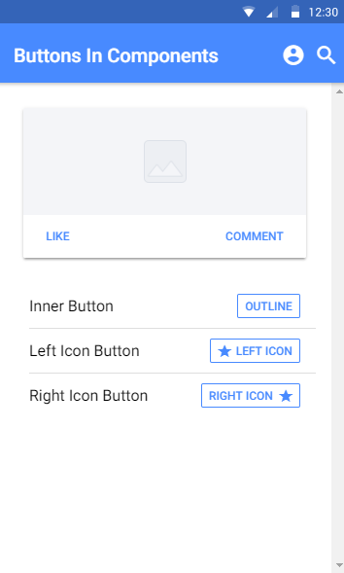
COMBO-BREAKER COMPONENTS
Why settle for one component when you can have more?
By combining components we can create our own super-components that really work for our users
Beware though, not all of them can be combined. To avoid hideous franken-ponants ask yourself the Jurassic question: “I could do this, but should I?” Let’s take a look at a quick example…

Slide 18
What Did We Learn This Month?
Forgot what you know about the navigation stack (told you to trust me)
Types of navigation
What Ionic can really do with some cool components

Slide 19
This Month’s Challenge!
Pick a component that we haven’t tried yet and add it to your app using the Ionic Documentation.

Slide 20
NEED HELP?
Github:
http://www.github.com/webdevelopwolf/training
Twitter:
http://www.twitter.com/webdevelopwolf
Facebook:
http://www.facebook.com/webdevwolf

Slide 21

Next Month…
We’re going to be carrying on looking at our components and how we can apply them to our delivery app. Hope to see you all next month ☺

